Slide 1
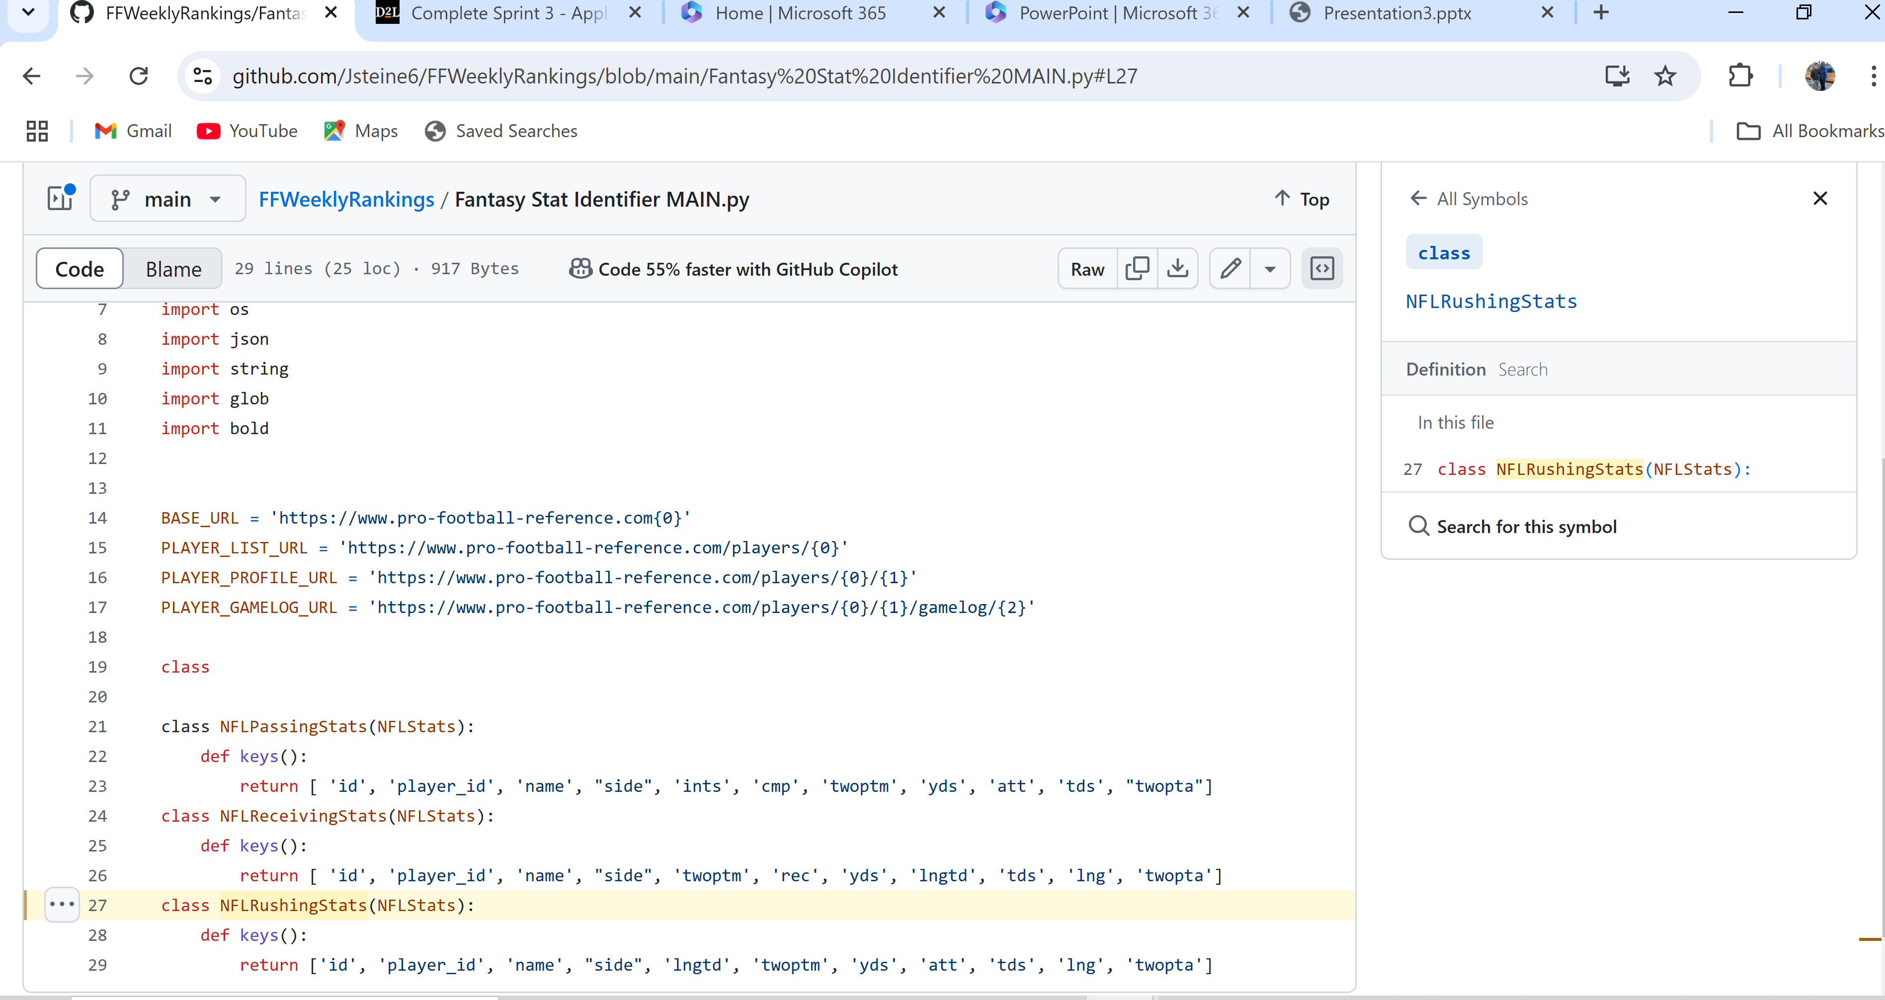


Fantasy Football Rankings
Jack Steiner
https://github.com/Jsteine6/FFWeeklyRankings
This code identifies the stats of each NFL player, assessing strength of schedule, yards per carry, and other analytics to deliver the best fantasy rankings.

